Slide 1
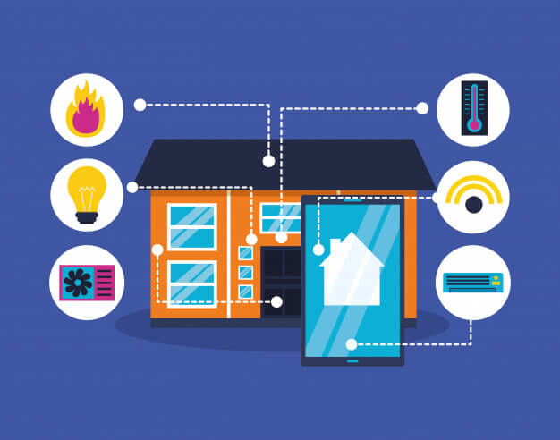


HOME AUTOMATION SYSTEM

Slide 2
Agenda
Introduction
Background
Procedure
Working flowchart
Objective
Result
Code
Conclusion

Slide 3
INTRODUCTION

Slide 4
According to the idea of the "Internet of Things," each device is assigned an IP address, which anybody may use to search for that device online. It is a dynamic system, the Internet. It was initially introduced as the "Internet of Computers." Future predictions indicate a fast increase in the number of "things" or devices connected to the Internet. The resulting network is known as the "Internet of Things" (IoT). IoT has the power to change people's way of life. In today's world, automatic systems are preferred over manual ones.
The primary elements of an IoT-based home automation system are the Raspberry Pi, the Relay, and their accompanying circuitry. Home automation is a method that substitutes pre-programmed electronic devices for as much human contact as is technologically feasible and desired in different home tasks. In the end, it's a system that attempts to improve quality of life through the automation of home appliances that can be managed via the phone or the internet.
4

Slide 5
BACKGROUND

Slide 6
The creation of an Internet of Things (IoT)-based home automation system utilising a Raspberry Pi is suggested in this article. Today, it's rare to find a home without some sort of home automation system. The goal of this project is to build a home automation system that enables you to manage your appliances from any mobile device. IoT is the foundation of this home automation system. When new technologies like the Internet of Things (IoT) are used, the field of home automation is particularly fascinating. Computer the size of a credit card is Raspberry Pi. Numerous peripherals are supported by the Raspberry Pi. The Raspberry Pi supports a variety of communication channels, including Bluetooth LE, Bluetooth, HDMI, USB, Display Serial Interface, Camera Serial Interface, and Bluetooth. It enables simultaneous control of many household appliances.
The idea of home automation first emerged in the 19th century. The Electronic Computing Home Operator, which was created in April 1968 using a set of extra electronics, has been improved. The X10 standard was further developed to enable radio frequency broadcasting of messages like "turn ON" and "turn OFF" between transmitters and receivers. The X10 system has a number of drawbacks. Home automation is now incredibly simple and exciting thanks to the Raspberry Pi, a little computer the size of a credit card that has several peripherals and communication interfaces including Ethernet, USB, and HDMI.
This article gives a brief overview of the Internet of Things (IoT), its applications, and possible social advantages.
Scientists, business leaders, and governments from all around the world are paying close attention to IoT because of its potential to transform modern living. The Internet of Things (IoT) is envisioned as a network of billions of sensors connected to the web via wireless and other communication methods. The sensors would produce a lot of data, which would need to be processed, understood, and used. house automation systems leverage the Internet of Things to enable remote monitoring and control of electrical and electronic items at the house using just a smartphone. A versatile, low-cost home automation system implementation is provided.
6

Slide 7
OBJECTIVE
7

Slide 8
Raspberry Pi home automation has the following goals:
1. Create a scalable home automation system by: The main goal is to develop a home automation system that is easily expandable to support different devices and functionality. The system should be flexible and adaptable enough to accommodate the addition of new gadgets and features without requiring large alterations, giving the homeowner the freedom to change their wants and preferences as they do.
2. Give homeowners alternatives for customization: Another goal is to provide possibilities for customization so that homeowners may design their home automation system to meet their own needs. This gives homeowners complete control over their smart home environment and includes the ability to choose and configure devices, set up automation rules, and establish personalised settings for various circumstances.
3. provide remote accessibility and control: The home automation system should provide remote accessibility and control, enabling homeowners to keep an eye on and manage their home appliances using smartphones, tablets, and other internet-connected devices from anywhere at any time. Homeowners will be able to remotely operate their smart home thanks to this purpose, which intends to give them convenience, flexibility, and increased security.
4. Use resources wisely for effective performance: A Raspberry Pi-based home automation system must use resources wisely in order to operate well. This entails making the most use of the system's processing capacity, memory, storage, and network connectivity to cut down on lag times, increase responsiveness, and improve system performance as a whole.
8

Slide 9
5. Ensure cost-effectiveness: The goal is to create a home automation system that is both affordable and functionally equivalent to or superior than the market's current offerings. This entails making use of the Raspberry Pi's low cost as a hardware platform,
minimising licencing expenses by using open-source software and tools, and maximising resource usage to save operating costs.
6. Improve user interface and experience: Creating a user-friendly interface that gives a seamless and intuitive user experience is another goal. Designing a user interface that is simple to use, visually appealing, and gives precise feedback on the status of devices and automation rules is part of this process. The goal is to make the home automation system accessible and user-friendly for homeowners with different levels of technological proficiency.
7. Security and privacy should always be prioritised in home automation systems. Implementing strong security measures is the goal in order to guard against unapproved access, data breaches, and other security risks. In order to provide homeowners control over their personal information and data, privacy issues relating to data collecting, storage, and utilisation need also be addressed.
By meeting these goals, a home automation system powered by Raspberry Pi may provide homeowners a reliable, cost-effective, customizable, remote-accessible, and secure way to manage their smart home, boosting their comfort and convenience as well as their quality of life in general.
9

Slide 10
PROCEDURE

Slide 11
The approach or process for putting a Raspberry Pi-based home automation system in place may be broken down into many steps:
1. System Design: Based on the particular requirements of the homeowner, specify the capabilities and requirements of the home automation system. The devices that will be automated, the required automation rules and situations, and the user interface for managing and monitoring the system are all included in this.
2. Hardware Selection and Configuration: Based on the needs of the home automation system, select the right Raspberry Pi model. Install the operating system, such as Raspbian, and attach any necessary peripherals, such as sensors, actuators, and communication modules (such as Wi-Fi, Bluetooth, Zigbee, etc.), to the Raspberry Pi board.
3. Software Development: Create the software elements of the home automation system using Python, Node.js, or other Raspberry Pi-compatible programming languages. For interacting with sensors and actuators, this may entail designing drivers or libraries, putting automation rules and logic into place, and building a user interface.
4. Define and put into practise the automation rules and logic that direct how the home automation system behaves. Depending on the desired automation scenarios, this may entail setting up triggers (such as sensor readings, time-based events, or user input) and actions (such as operating actuators or sending messages).
5. Designing and creating a user-friendly interface is important for managing and controlling a home automation system. A web-based or mobile application that enables users to communicate with the system, define automation rules, see status and notifications, and manage devices in their smart home may be developed as part of this.
11

Slide 12
6. Testing and debugging: To assure the home automation system's appropriate functioning, dependability, and security, test it extensively. Determine and address any problems or errors that may appear during the testing process, and enhance system performance to guarantee effective resource use.
7. Integration and Deployment: Once the home automation system has been completely designed and tested, it should be installed in the target environment, which is the homeowner's house. As required, integrate the system with the already-installed household appliances, including smart lighting, thermostats, security systems, etc.
8. Home automation system documentation and user training materials should be made available to homeowners so they can use and maintain the system. To assist homeowners in properly using and troubleshooting the system, this may include user manuals, tutorials, and support materials.
9. Ongoing Upkeep and Updates: To guarantee the home automation system's continuing flawless operation, regularly check and maintain it. To maintain the system current and safe, update the firmware, security features, and software components as necessary.
This methodology/procedure may be used to effectively create a home automation system utilising a Raspberry Pi, giving homeowners access to a smart and controlled home environment that gives comfort, convenience, and control over their gadgets and appliances.
12

Slide 13
RESULT

Slide 14
For homeowners, the outcomes of putting a home automation system together with a Raspberry Pi might be quite advantageous. Here are some possible consequences or outcomes:
1. Enhanced Convenience and Comfort: Home automation enables homeowners to easily control their gadgets and appliances as well as automate a variety of functions. For instance, they can save time and effort by remotely controlling lights, thermostats, security systems, and other equipment. Homeowners may design custom automation rules to fit their interests and lifestyles, which can boost convenience and comfort by streamlining and improving regular activities.
2. Enhanced Energy Efficiency: Home automation may assist in maximising energy use, which may result in energy savings and lower utility costs. In order to save energy, homeowners can, for instance, programme automation rules to switch lights off or change temperatures when rooms are empty. This may help create a more environmentally friendly and sustainable home environment.
3. Customizability and Flexibility: Raspberry Pi-based home automation systems may provide significant levels of customization and flexibility, enabling homeowners to design the system to suit their own requirements and preferences. To design a smart home that fits their lifestyle, tastes, and budget, they may select from a variety of sensors, actuators, and automation rules.
4. Remote Accessibility and Control: With the help of home automation and a Raspberry Pi, homeowners can access and manage their home appliances from anywhere at any time. By enabling homeowners to monitor and handle their smart home even when they are not physically there, this may offer convenience and flexibility.
14

Slide 15
5. Cost-Effective Solution: When compared to other proprietary systems on the market, the Raspberry Pi can provide a more economical and accessible hardware platform for the implementation of a home automation system. As a result, homeowners may find home automation to be more accessible and reasonable, enabling them to take advantage of the advantages of a smart home without breaking the bank.
Homeowners can benefit from a smart and automated home environment that improves their comfort, convenience, and overall quality of life by implementing a home automation system using a Raspberry Pi. These benefits may include increased convenience, energy efficiency, security, customization, remote accessibility, and cost effectiveness.
15

Slide 16
WORKING FLOWCHART

Slide 17
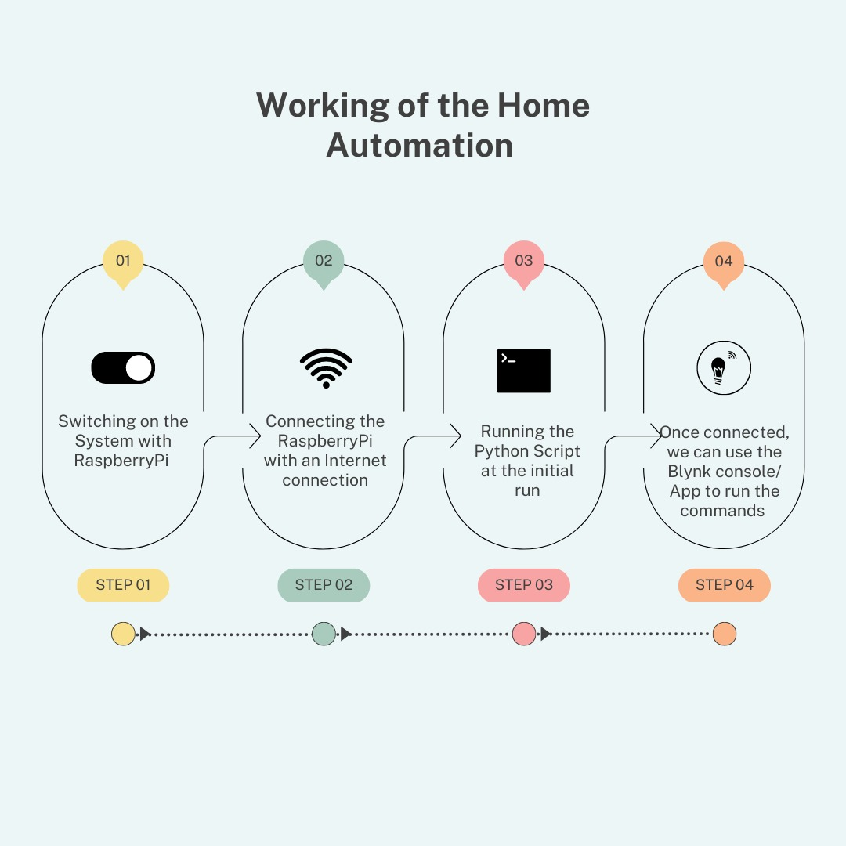
17

Slide 18
CODE

Slide 19
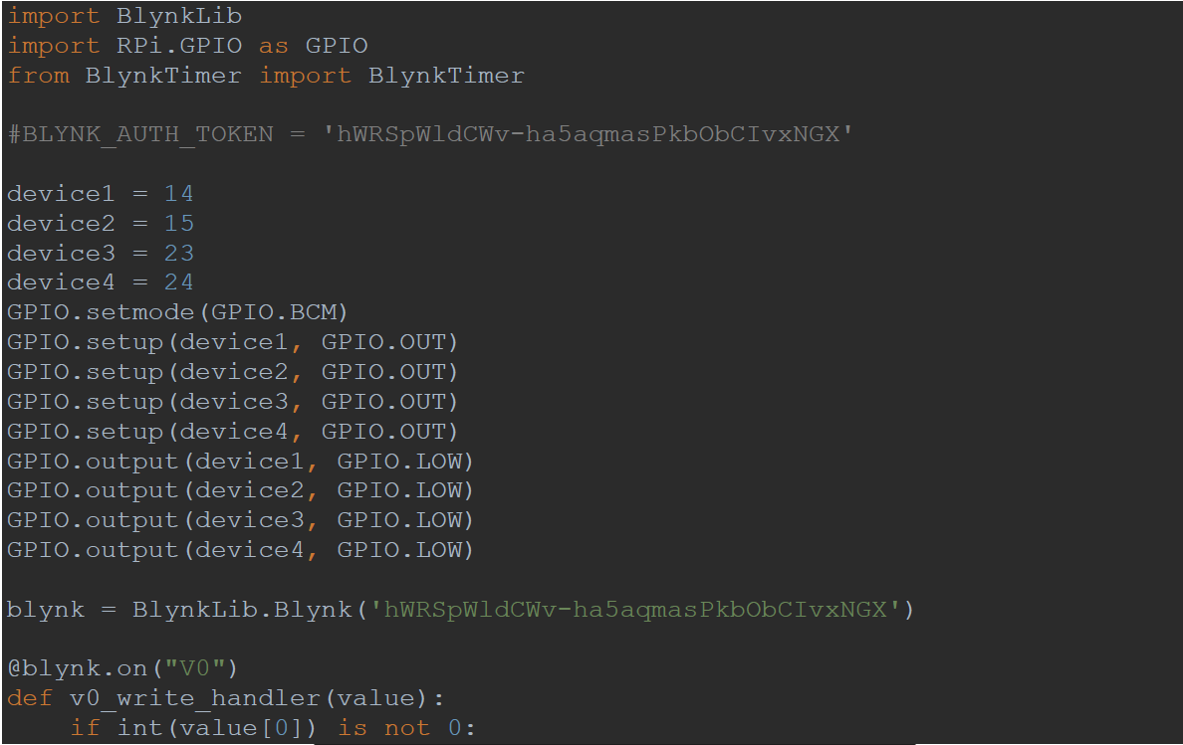
19

Slide 20
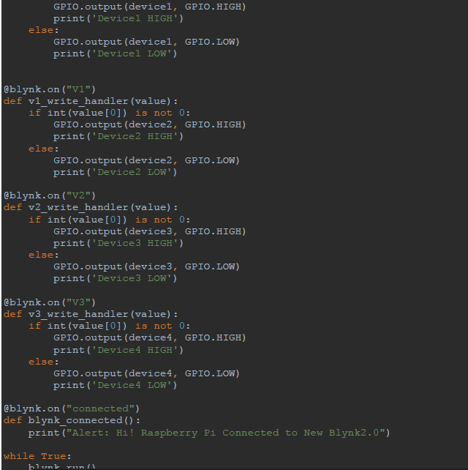
20

Slide 21
CONCLUSION

Slide 22
In conclusion, utilising a Raspberry Pi to automate your house has several benefits for you. It increases comfort, versatility, and convenience while monitoring and controlling different household appliances and gadgets. Additionally, it encourages energy conservation, security, and customization, enabling homeowners to design a smart home that suits their tastes and requirements. Due to the low cost of Raspberry Pi-based home automation solutions, more people can afford and have access to smart homes. Additionally, setting up a home automation system using a Raspberry Pi may provide chances for learning and do-it-yourself projects, giving homeowners control over their smart homes and encouraging a sense of ownership.
However, it's crucial to keep in mind that utilising a Raspberry Pi to construct a home automation system necessitates technical expertise in programming, electronics, and networking. The smart home system should be protected against potential cyber attacks while also maintaining security and privacy. Additionally, it may be necessary to give considerable thought to and prepare for the interoperability and integration of various systems and devices in a home automation setup.
Despite these factors, there is a lot of potential for traditional homes to become smart homes through home automation utilising Raspberry Pi, providing homeowners with convenience, efficiency, and customisation. Raspberry Pi-based home automation systems may offer enormous benefits to homeowners with the right design, implementation, and maintenance, making their lives simpler, more comfortable, and pleasurable in a connected and automated home environment.
22

Slide 23
Thank you

